Slide 1

PIERIAN CLOUD

Slide 3

Google Cloud Associate Cloud Engineer
Virtual Machines

Slide 4
Google Cloud Associate Cloud Engineer
One of the most common use cases of the cloud is using virtual machines.
We’ve covered some aspects of virtual machines, but this section will take a much deeper look at the various aspects of virtual machines on Google Cloud.

Slide 5
Google Cloud Associate Cloud Engineer
Section Overview:
Compute Engine Overview
VM Options:
Image
Disk
Compute
VM Lifecycle
Compute Pricing Considerations
Common VM Actions

Slide 6
Google Cloud Associate Cloud Engineer
Let’s get started!

Slide 7
Google Cloud Associate Cloud Engineer
Compute Engine
Overview

Slide 8
Google Cloud Associate Cloud Engineer
While you will most commonly start off with Compute Engine as your VM on Google Cloud, we should note there are a variety of services and technologies that act as VMs on GCP.
Let’s briefly go over their differences and use cases.

Slide 9
Google Cloud Associate Cloud Engineer
 | Language Support | Service Type | Scaling Type | Use Case
Compute Engine | Any | IaaS | Server Autoscaling | General Workloads
Kubernetes Engine | Any | IaaS PaaS | Cluster | Container Workloads
App Engine (Standard and Flexible) | Python, Node.js, Go, Java, PHP, Ruby, .NET | PaaS | Autoscaling Managed Servers | Web Apps Mobile Backends
Cloud Functions | Python, Node.js, Go | Microservices Architecture | Serverless | Event Actions

Slide 10

Google Cloud Associate Cloud Engineer
 | Language Support | Service Type | Scaling Type | Use Case
Compute Engine | Any | IaaS | Server Autoscaling | General Workloads
Kubernetes Engine | Any | IaaS PaaS | Cluster | Container Workloads
App Engine (Standard and Flexible) | Python, Node.js, Go, Java, PHP, Ruby, .NET | PaaS | Autoscaling Managed Servers | Web Apps Mobile Backends
Cloud Functions | Python, Node.js, Go | Microservices Architecture | Serverless | Event Actions

Slide 11

Google Cloud Associate Cloud Engineer
 | Language Support | Service Type | Scaling Type | Use Case
Compute Engine | Any | IaaS | Server Autoscaling | General Workloads
Kubernetes Engine | Any | IaaS PaaS | Cluster | Container Workloads
App Engine (Standard and Flexible) | Python, Node.js, Go, Java, PHP, Ruby, .NET | PaaS | Autoscaling Managed Servers | Web Apps Mobile Backends
Cloud Functions | Python, Node.js, Go | Microservices Architecture | Serverless | Event Actions

Slide 12

Google Cloud Associate Cloud Engineer
 | Language Support | Service Type | Scaling Type | Use Case
Compute Engine | Any | IaaS | Server Autoscaling | General Workloads
Kubernetes Engine | Any | IaaS PaaS | Cluster | Container Workloads
App Engine (Standard and Flexible) | Python, Node.js, Go, Java, PHP, Ruby, .NET | PaaS | Autoscaling Managed Servers | Web Apps Mobile Backends
Cloud Functions | Python, Node.js, Go | Microservices Architecture | Serverless | Event Actions

Slide 13

Google Cloud Associate Cloud Engineer
 | Language Support | Service Type | Scaling Type | Use Case
Compute Engine | Any | IaaS | Server Autoscaling | General Workloads
Kubernetes Engine | Any | IaaS PaaS | Cluster | Container Workloads
App Engine (Standard and Flexible) | Python, Node.js, Go, Java, PHP, Ruby, .NET | PaaS | Autoscaling Managed Servers | Web Apps Mobile Backends
Cloud Functions | Python, Node.js, Go | Microservices Architecture | Serverless | Event Actions

Slide 14
Google Cloud Associate Cloud Engineer
 | Language Support | Service Type | Scaling Type | Use Case
Compute Engine | Any | IaaS | Server Autoscaling | General Workloads
Kubernetes Engine | Any | IaaS PaaS | Cluster | Container Workloads
App Engine (Standard and Flexible) | Python, Node.js, Go, Java, PHP, Ruby, .NET | PaaS | Autoscaling Managed Servers | Web Apps Mobile Backends
Cloud Functions | Python, Node.js, Go | Microservices Architecture | Serverless | Event Actions

Slide 15
Google Cloud Associate Cloud Engineer
Compute Engine provides predefined instances for general computing, compute optimized, and memory optimized.
You can also define your own custom VM for your own special use cases.

Slide 16
Google Cloud Associate Cloud Engineer
Compute Engine is GCP’s core IaaS (Infrastructure as a Service) offering.
You define your machine type:
vCPUs
RAM
Disk
Networking
OS (Image)

Slide 17
Google Cloud Associate Cloud Engineer
Let’s briefly go through some of these key components of a Compute Engine.
Later on we’ll do deeper dives into some of the components, like Disk and Image.

Slide 18
Google Cloud Associate Cloud Engineer
Compute
Each virtual CPU (vCPU) is implemented as a single hardware multithread on one of the available CPU processors.
Different generations of Compute Engine will have different Intel CPU chips available (and different costs).

Slide 19
Google Cloud Associate Cloud Engineer
Compute
For applications that work better on GPUs, Compute Engine also has a variety of NVIDIA GPU options available for use.
TPU (Tensor Processing Units) for specialized deep learning tasks are also available.

Slide 20
Google Cloud Associate Cloud Engineer
Compute
You can also specify the RAM (Random Access Memory) available to the VM instance.
Very high memory VMs are available (e.g. 3.75 TB RAM) but be aware of their price!

Slide 21
Google Cloud Associate Cloud Engineer
Throughput Bandwidths
Network scales to 2 Gb per second (Gbps) per vCPU.
Max of 32 Gbps with 16 vCPU or 100 Gbps with V100, T4, and A100 GPUs.

Slide 22
Google Cloud Associate Cloud Engineer
Disk Options
Standard
Spinning hard disk drive
SSD
Solid State Drives
Local SSD
Gone once instance is stopped or terminated.

Slide 23
Google Cloud Associate Cloud Engineer
Networking
Default, Auto, Custom Networks
Firewall Rules
Load Balancing
Subnetwork Connections

Slide 24
Google Cloud Associate Cloud Engineer
Review:
We discussed the VM options on Google Cloud and went over some key components when creating a new Compute Engine instance.

Slide 25
Google Cloud Associate Cloud Engineer
Up Next:
We’ll have a deeper discussion on Images for your VM instance.

Slide 26
Google Cloud Associate Cloud Engineer
Image Options

Slide 27
Google Cloud Associate Cloud Engineer
An image for a VM instance includes a boot loader, operating system, file system structure, and any additional software or customizations you want to add.

Slide 28
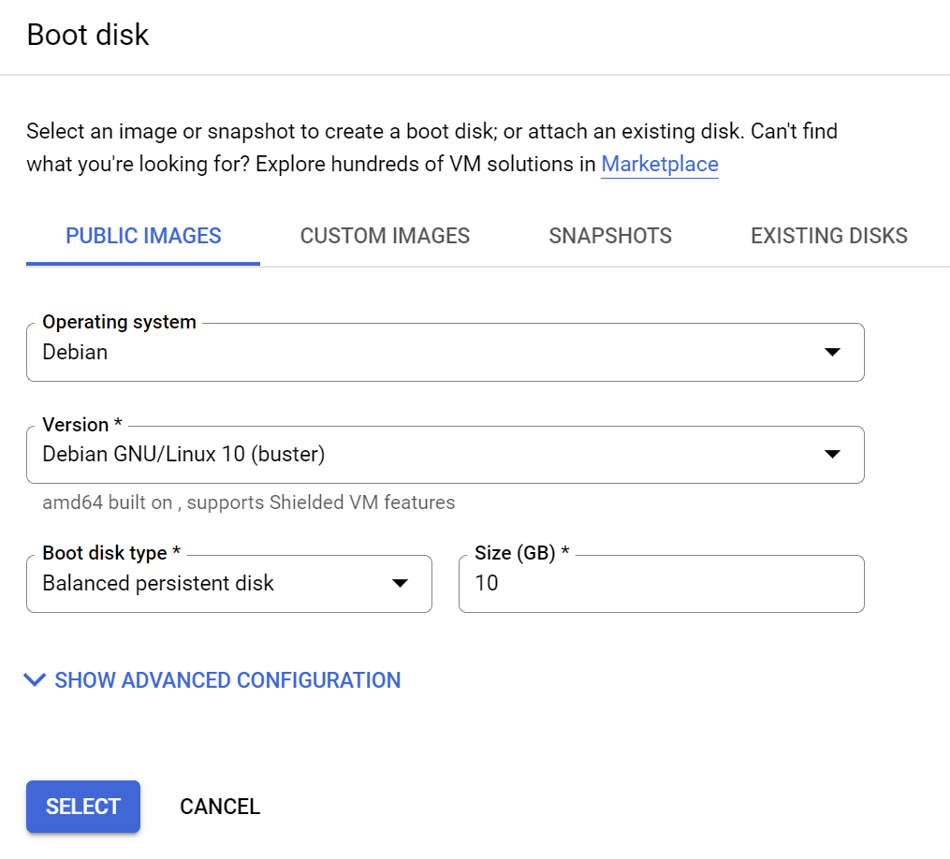
Google Cloud Associate Cloud Engineer
When you create a new VM Instance, you can specify an image for the VM.

Slide 29
Google Cloud Associate Cloud Engineer
There are two main types of images:
Public Image
Custom Image

Slide 30
Google Cloud Associate Cloud Engineer
Public Image:
Linux
CentOS, CoreOS, Debian, Ubuntu, and more.
Windows
Windows Server
SQL Server Pre-Installed on Windows

Slide 31
Google Cloud Associate Cloud Engineer
Public Image:
Google, 3rd Party, and Premium Images are available as well.
For example, a “Deep Learning on Linux” OS can be provided with common machine learning libraries installed and optimized for Intel.

Slide 32
Google Cloud Associate Cloud Engineer
Public Image:
Be aware that certain premium images may have an increased pricing structure and charge per minute.
Review your VM pricing forecast after selecting the Image and remember to explore the marketplace.

Slide 33
Google Cloud Associate Cloud Engineer
Custom Image:
You can create a custom image by pre-installing software for your VM instance.

Slide 34
Google Cloud Associate Cloud Engineer
Custom Image:
You can also import images from your own premises, workstations, or even other cloud providers.
GCP also offers a variety of Image management features.

Slide 35
Google Cloud Associate Cloud Engineer
A machine image is a Compute Engine resource that stores all the configuration, metadata, permissions, and data from multiple disks of a virtual machine (VM) instance.
You can use a machine image in many system maintenance, backup and recovery, and instance cloning scenarios.

Slide 36
Google Cloud Associate Cloud Engineer
Scenarios | Machine image | Persistent disk snapshot | Custom image | Instance template
Single disk backup | Yes | Yes | Yes | No
Multiple disk backup | Yes | No | No | No
Differential backup | Yes | Yes | No | No
Instance cloning | Yes | No | Yes | Yes
Base image for replication | No | No | Yes | No

Slide 37
Google Cloud Associate Cloud Engineer
Review:
We explored the variety of options available for Images when creating a VM instance and the ability to create backups with a machine image.

Slide 38
Google Cloud Associate Cloud Engineer
Up Next:
We’ll dive deeper into disk options when creating a VM instance.

Slide 39
Google Cloud Associate Cloud Engineer
Disk Options

Slide 40
Google Cloud Associate Cloud Engineer
After deciding on an Image, you have an operating system in place.
However, this OS and corresponding image need to be on a disk to be booted from which is actually separate from the VM.
Let’s explore our disk options…

Slide 41
Google Cloud Associate Cloud Engineer
Boot Disk
Every VM comes with a single root persistent disk
Bootable
Can be attached to a VM and VM can boot from it.
Durable
Can “survive” a VM termination.

Slide 42
Google Cloud Associate Cloud Engineer
Boot Disk
For durability beyond the VM termination, disable the option:
“Delete boot disk when instance is deleted”

Slide 43
Google Cloud Associate Cloud Engineer
Persistent Disk
Attached to the VM through the network interface allowing for snapshots which are “in the moment” incremental backups.
Users can choose between HDD or SSD for better performance (with costs).

Slide 44
Google Cloud Associate Cloud Engineer
Persistent Disk
Disks can be resized even if already attached to a VM and running.
Can be attached to multiple VMs in a “read only” mode.

Slide 45
Google Cloud Associate Cloud Engineer
Persistent Disk
GCP encrypts all data at rest by default.
GCP also manages the encryption key for you, but does give you the option to have customer managed or customer supplied keys as well.

Slide 46
Google Cloud Associate Cloud Engineer
Persistent Disk
There are several options for disks available.
More info:
cloud.google.com/compute/docs/disks

Slide 47
Google Cloud Associate Cloud Engineer
Zonal standard PD | Regional standard PD | Zonal balanced PD | Regional balanced PD | Zonal SSD PD | Regional SSD PD | Zonal extreme PD | Local SSDs | Cloud Storage buckets
Efficient and reliable block storage | Efficient and reliable block storage with synchronous replication across two zones in a region | Cost-effective and reliable block storage | Cost-effective and reliable block storage with synchronous replication across two zones in a region | Fast and reliable block storage | Fast and reliable block storage with synchronous replication across two zones in a region | Highest performance persistent block storage option | High performance local block storage | Affordable object storage

Slide 48
Google Cloud Associate Cloud Engineer
Zonal standard PD | Regional standard PD | Zonal balanced PD | Regional balanced PD | Zonal SSD PD | Regional SSD PD | Zonal extreme PD | Local SSDs | Cloud Storage buckets
Efficient and reliable block storage | Efficient and reliable block storage with synchronous replication across two zones in a region | Cost-effective and reliable block storage | Cost-effective and reliable block storage with synchronous replication across two zones in a region | Fast and reliable block storage | Fast and reliable block storage with synchronous replication across two zones in a region | Highest performance persistent block storage option | High performance local block storage | Affordable object storage

Slide 49
Google Cloud Associate Cloud Engineer
Local SSD
Physically attached to the VM
Lower Latency
Higher Throughput (at higher cost)
VM Specific
Data does not survive a stop or termination

Slide 50
Google Cloud Associate Cloud Engineer
RAM Disk
You can use tmpfs command to use RAM disks.
You can allocate some of this memory to create a RAM disk with exceptionally low latency and high throughput.
RAM disks work well when your application expects a file system structure and cannot simply store its data in memory.

Slide 51
Google Cloud Associate Cloud Engineer
RAM Disk
RAM disks alone do not provide any storage redundancy or flexibility, so it is best to use RAM disks in combination with other instance storage options.

Slide 52
Google Cloud Associate Cloud Engineer
RAM Disk
RAM disks share instance memory with your applications. If your instances do not have enough memory to contain RAM disks and your applications, create instances with high-memory machine types or upgrade your existing instances to add more memory.

Slide 53
Google Cloud Associate Cloud Engineer
 | PD - HDD | PD - SSD | Local SSD | RAM Disk
Use Case | General and bulk file storage | Volatile I/O per second | High IO per second and low latency | Low Latency but with no persistent data
Bootable | Yes | Yes | Yes | N/A
Snapshots | Yes | Yes | No | No
Data Redundancy | Yes | Yes | No | No
Encryption | Yes | Yes | Yes | N/A

Slide 54
Google Cloud Associate Cloud Engineer
Keep in mind that in the end, just like virtual networks and virtual machines, a persistent disk is a cloud feature that is virtually connected to your VM through software.
Except in the case of a Local SSD

Slide 55
Google Cloud Associate Cloud Engineer
This means we can easily resize the cloud persistent disks, have automatic encryption, and use built-in snapshot services.
All of these features are not possible or very difficult to achieve with classic physical computer hardware disks.

Slide 56
Google Cloud Associate Cloud Engineer
Review:
We have lots of options for disks for our VMs and many advantages come from the persistent cloud aspects of the disks.

Slide 57
Google Cloud Associate Cloud Engineer
Up Next:
Let’s explore the options available for compute on an instance.

Slide 58
Google Cloud Associate Cloud Engineer
Compute Options

Slide 59
Google Cloud Associate Cloud Engineer
We’ve mentioned there are different machine types, let’s take a look at the different options we have available.

Slide 60
Google Cloud Associate Cloud Engineer
Machine Families
A curated set of processor and hardware configurations optimized for specific workloads. When you create a VM instance, you choose a predefined or custom machine type from your preferred machine family.

Slide 61
Google Cloud Associate Cloud Engineer
Series
Machine families are further classified by series and generation. For example, the N1 series within the general-purpose machine family is the older version of the N2 series. Generally, generations of a machine series use a higher number to describe the newer generation.

Slide 62
Google Cloud Associate Cloud Engineer
Machine Type
Every machine series has predefined machine types that provide a set of resources for your VM. If a predefined machine type does not meet your needs, you can also create a custom machine type.

Slide 63
Google Cloud Associate Cloud Engineer
Machine Family Options:
General Purpose
Compute Optimized
Memory Optimized
Accelerator Optimized

Slide 64
Google Cloud Associate Cloud Engineer
Machine Family Options:
General Purpose
Best price-performance ratio for a variety of workloads.

Slide 65
Google Cloud Associate Cloud Engineer
Machine Family Options:
Compute-optimized
Highest performance per core on Compute Engine and optimized for compute-intensive workloads.

Slide 66
Google Cloud Associate Cloud Engineer
Machine Family Options:
Memory-optimized
Ideal for memory-intensive workloads, offering more memory per core than other machine families, with up to 12 TB of memory.

Slide 67
Google Cloud Associate Cloud Engineer
Machine Family Options:
Accelerator-optimized
Ideal for massively parallelized Compute Unified Device Architecture (CUDA) compute workloads, such as machine learning (ML) and high performance computing (HPC).

Slide 68
Google Cloud Associate Cloud Engineer
Information on the details regarding machine families, series, and types can be found here:
cloud.google.com/compute/docs/ machine-types

Slide 69
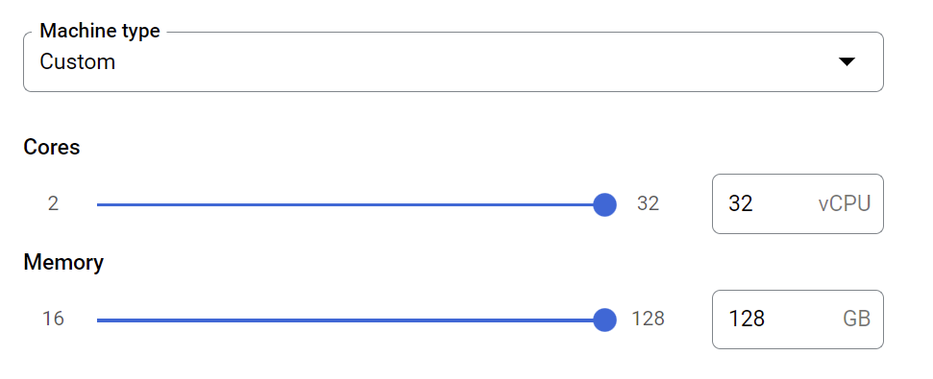
Google Cloud Associate Cloud Engineer
Custom Compute Options:
Specify Cores and Memory to fit your use case.

Slide 70
Google Cloud Associate Cloud Engineer
Custom Compute Options:
Keep in mind not every Region or Zone contains all possible hardware.
You may need to switch zones if looking for a particular GPU for example.

Slide 71
Google Cloud Associate Cloud Engineer
Review:
We learned about the compute options available when creating a VM instance.

Slide 72
Google Cloud Associate Cloud Engineer
Up Next:
We’ll create a new VM instance and explore the topics we discussed on the Google Cloud Console.

Slide 73
Google Cloud Associate Cloud Engineer
VM Lifecycle

Slide 74
Google Cloud Associate Cloud Engineer
When creating a new VM instance, the creator has full root privileges on that instance.
Accessing an instance is slightly different depending on the base OS Image.

Slide 75
Google Cloud Associate Cloud Engineer
Linux OS:
SSH from GCP Console or Cloudshell
Can also generate key pairs
Information:
cloud.google.com/compute/docs/ instances/connecting-to-instance

Slide 76
Google Cloud Associate Cloud Engineer
Windows OS:
RDP (Remote Desktop Protocol)
Powershell Terminal and setting Windows Password
Information:
cloud.google.com/compute/docs/ instances/connecting-to-windows

Slide 77
Google Cloud Associate Cloud Engineer
Now that we understand how to access our VM instance, let’s explore the VM lifecycle!

Slide 78
Google Cloud Associate Cloud Engineer
Provisioning
vCPU + Memory
Root Disk
Persistent Disk
Added Disks

Slide 79
Google Cloud Associate Cloud Engineer
Provisioning
Staging
vCPU + Memory
IP Addresses
Root Disk
Persistent Disk
System Image
Added Disks
Boot Process

Slide 80
Google Cloud Associate Cloud Engineer
Provisioning
Staging
Running
vCPU + Memory
IP Addresses
Startup Script
Root Disk
Persistent Disk
System Image
Access with SSH/RDP
Added Disks
Boot Process
Change/Modify

Slide 81
Google Cloud Associate Cloud Engineer
Provisioning
Staging
Running
Modifying VM
vCPU + Memory
IP Addresses
Startup Script
Moving VM to another Zone
Snapshot of Persistent Disk
Root Disk
Persistent Disk
System Image
Access with SSH/RDP
Export System Image
Added Disks
Boot Process
Change/Modify
set or get
metadata

Slide 82
Google Cloud Associate Cloud Engineer
Provisioning
Staging
Running
vCPU + Memory
IP Addresses
Startup Script
Root Disk
Persistent Disk
System Image
Access with SSH/RDP
Added Disks
Boot Process
Modifying VM

Slide 83
Google Cloud Associate Cloud Engineer
Provisioning
Staging
Running
Stopping
vCPU + Memory
IP Addresses
Startup Script
Shutdown
Script
Root Disk
Persistent Disk
System Image
Access with SSH/RDP
Added Disks
Boot Process
Modifying VM

Slide 84
Google Cloud Associate Cloud Engineer
Provisioning
Staging
Running
Stopping
Terminated
vCPU + Memory
IP Addresses
Startup Script
Shutdown
Script
Availability
Policy
Delete
Root Disk
Persistent Disk
System Image
Access with SSH/RDP
Added Disks
Boot Process
Modifying VM

Slide 85
Google Cloud Associate Cloud Engineer
RESTART
Provisioning
Staging
Running
Stopping
Terminated
vCPU + Memory
IP Addresses
Startup Script
Shutdown
Script
Availability
Policy
Delete
Root Disk
Persistent Disk
System Image
Access with SSH/RDP
Added Disks
Boot Process
Modifying VM

Slide 86
Google Cloud Associate Cloud Engineer
Provisioning
Staging
Running
Stopping
Terminated
vCPU + Memory
IP Addresses
Startup Script
Shutdown
Script
Availability
Policy
Delete
Root Disk
Persistent Disk
System Image
Access with SSH/RDP
Added Disks
Boot Process
Modifying VM

Slide 87
Google Cloud Associate Cloud Engineer
RESET
Provisioning
Staging
Running
Stopping
Terminated
vCPU + Memory
IP Addresses
Startup Script
Shutdown
Script
Availability
Policy
Delete
Root Disk
Persistent Disk
System Image
Access with SSH/RDP
Added Disks
Boot Process
Modifying VM

Slide 88
Google Cloud Associate Cloud Engineer
Review:
We learned about the typical VM lifecycle including provisioning, staging, running, stopping, and terminating an instance.

Slide 89
Google Cloud Associate Cloud Engineer
Up Next:
We’ll explore considerations on compute pricing.

Slide 90
Google Cloud Associate Cloud Engineer
Compute Pricing

Slide 91
Google Cloud Associate Cloud Engineer
Let’s discuss the pricing of using the compute engine as well as some useful discounts

Slide 92
Google Cloud Associate Cloud Engineer
GCP offers per-second billing for compute usage (minimum of 1 minute):
vCPUs, GPUs, and GB of Memory
Each vCPU and each GB of memory is billed separately.

Slide 93
Google Cloud Associate Cloud Engineer
Machine Type Recommendations:
Compute Engine provides machine type recommendations to help you optimize the resource utilization of your virtual machine (VM) instances.

Slide 94
Google Cloud Associate Cloud Engineer
Machine Type Recommendations:
These recommendations are generated automatically based on system metrics gathered by the Cloud Monitoring service over the previous 8 days.

Slide 95
Google Cloud Associate Cloud Engineer
Machine Type Recommendations:
Use these recommendations to resize your instance's machine type to more efficiently use the instance's resources.
This feature is also known as rightsizing recommendations.

Slide 96
Google Cloud Associate Cloud Engineer
Discount Types:
Sustained Use
Committed Use
Preemptible VM Instances
Discount types can not be combined.

Slide 97
Google Cloud Associate Cloud Engineer
Sustained Use Discounts
Automatic discounts for running specific Compute Engine resources a significant portion of the billing month.

Slide 98
Google Cloud Associate Cloud Engineer
Sustained Use Discounts
For example, when you run one of these resources for more than 25% of a month, Compute Engine automatically gives you a discount for every incremental minute you use for that instance.

Slide 99
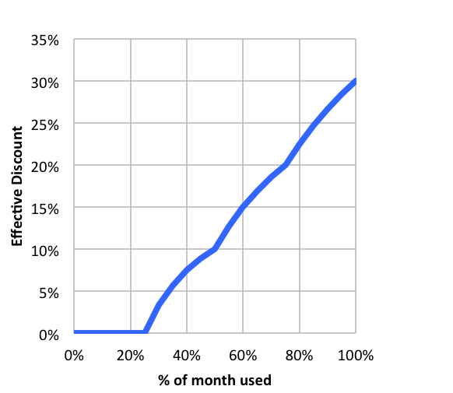
Google Cloud Associate Cloud Engineer
Sustained Use Discounts
These discounts can be significant:

Slide 100
Google Cloud Associate Cloud Engineer
Sustained Use Discounts
GCP is able to calculate the sustained usage at a resource level.

Slide 101

Google Cloud Associate Cloud Engineer
Sustained Use Discounts
Week 1 Week 2 (-10%) Week 3 (-20%) Week 4 (-30%)

Slide 102
Google Cloud Associate Cloud Engineer
Sustained Use Discounts
Week 1 Week 2 (-10%) Week 3 (-20%) Week 4 (-30%)
Week 1 Week 2 (-10%)

Slide 103
Google Cloud Associate Cloud Engineer
Sustained Use Discounts
cloud.google.com/compute/docs/ sustained-use-discounts

Slide 104
Google Cloud Associate Cloud Engineer
Committed Use Discounts
Compute Engine lets you purchase and renew committed use discounts in return for deeply discounted prices for VM usage.
These discounts are referred to as resource-based committed use discounts.

Slide 105
Google Cloud Associate Cloud Engineer
Committed Use Discounts
Information on signing up for committed use discounts:
cloud.google.com/compute/docs/ instances/signing-up-committed-use-discounts

Slide 106
Google Cloud Associate Cloud Engineer
Preemptible Instances
Preemptible VM instances are available at much lower price—a 60-91% discount—compared to the price of standard VMs. However, Compute Engine might stop (preempt) these instances if it needs to reclaim the compute capacity for allocation to other VMs.

Slide 107
Google Cloud Associate Cloud Engineer
Preemptible Instances
Preemptible instances use excess Compute Engine capacity, so their availability varies with usage.
If your apps are fault-tolerant and can withstand possible instance preemptions this can reduce your Compute Engine costs significantly.

Slide 108
Google Cloud Associate Cloud Engineer
Preemptible Instances
No charge if terminated in first minute
24 hours maximum
Only 30 second termination warning
Not guaranteed to warn
No live migrate
No auto restart

Slide 109
Google Cloud Associate Cloud Engineer
Preemptible Instances
Preemptible instances information and pricing:
cloud.google.com/compute/docs/ instances/preemptible

Slide 110
Google Cloud Associate Cloud Engineer
For full information on compute pricing make sure to check out the docs:
cloud.google.com/compute/all-pricing

Slide 111
Google Cloud Associate Cloud Engineer
Review:
We covered the pricing mechanics of compute engine and discussed discounts.

Slide 112
Google Cloud Associate Cloud Engineer
Up Next:
We’ll discuss some more specialized compute options.

Slide 113
Google Cloud Associate Cloud Engineer
Special Compute
Options

Slide 114
Google Cloud Associate Cloud Engineer
There are sometimes situations where compliance or security necessitates that your VM has physical isolation from other workloads.
In these cases you can use sole tenant nodes to have access to a physical Compute Engine server that is dedicated to hosting only your project's VMs.

Slide 115
Google Cloud Associate Cloud Engineer
Multi-Tenant Nodes
Sole Tenant Nodes
VM
VM
VM
VM
VM
VM
Hypervisor
Hypervisor
Hardware
Hardware

Slide 116
Google Cloud Associate Cloud Engineer
Sole Tenant Nodes:
VMs running on sole-tenant nodes can use the same Compute Engine features as other VMs, including transparent scheduling and block storage, but with an added layer of hardware isolation.

Slide 117
Google Cloud Associate Cloud Engineer
Sole Tenant Nodes:
Within a sole-tenant node, you can provision multiple VMs on machine types of various sizes, which lets you efficiently use the underlying resources of the dedicated host hardware.

Slide 118
Google Cloud Associate Cloud Engineer
Sole Tenant Nodes:
Since you aren't sharing the host hardware with other projects, you can meet security or compliance requirements with workloads that require physical isolation from other workloads or VMs.

Slide 119
Google Cloud Associate Cloud Engineer
Sole Tenant Nodes:
More information at:
https://cloud.google.com/compute/ docs/nodes/sole-tenant-nodes

Slide 120
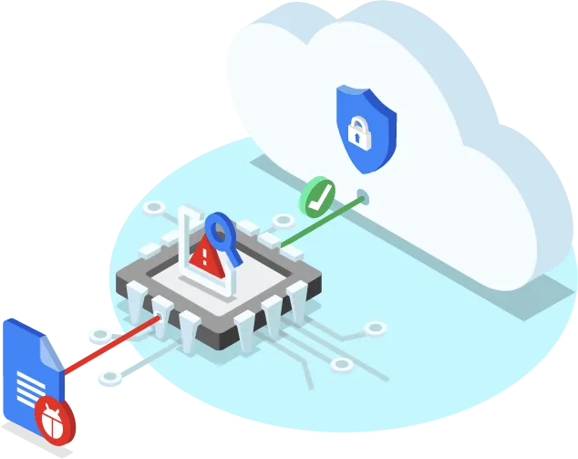
Google Cloud Associate Cloud Engineer
When security is a very high priority issue (beyond normal GCP security and encryption practices), you can use GCP Shielded VMs.

Slide 121
Google Cloud Associate Cloud Engineer
Shielded VMs:
Shielded VMs are virtual machines (VMs) on Google Cloud hardened by a set of security controls that help defend against rootkits and bootkits.

Slide 122
Google Cloud Associate Cloud Engineer
Shielded VMs:
Using Shielded VMs helps protect enterprise workloads from threats like remote attacks, privilege escalation, and malicious insiders.

Slide 123
Google Cloud Associate Cloud Engineer
Shielded VMs:
Shielded VMs leverage advanced platform security capabilities such as secure and measured boot, a virtual trusted platform module (vTPM), UEFI firmware, and integrity monitoring.

Slide 124
Google Cloud Associate Cloud Engineer
Shielded VMs:
In summary, Shielded VM offers verifiable integrity of your compute engine instances using:
Secure Boot
Virtual Trusted Platform Module
Integrity Monitoring

Slide 125
Google Cloud Associate Cloud Engineer
Shielded VMs:
More information at:
cloud.google.com/compute/ shielded-vm/docs/shielded-vm

Slide 126
Google Cloud Associate Cloud Engineer
Review:
We learned about special VM options including Sole-Tenant Nodes and Shielded VMs.

Slide 127
Google Cloud Associate Cloud Engineer
Up Next:
We’ll explore some common actions performed with VMs

Slide 128
Google Cloud Associate Cloud Engineer
VM Actions

Slide 129
Google Cloud Associate Cloud Engineer
Let’s quickly explore the specifics around some common VM actions:
Working with Metadata
Moving a VM Zone or Region
Creating a Snapshot
Resizing Persistent Disk

Slide 130
Google Cloud Associate Cloud Engineer
Instance Metadata:
Every virtual machine (VM) instance stores its metadata on a metadata server. Your VM automatically has access to the metadata server API without any additional authorization. Metadata is stored as key:value pairs.

Slide 131
Google Cloud Associate Cloud Engineer
Instance Metadata:
There is a default set of metadata keys that are available for VMs running on Compute Engine.
To query metadata:
cloud.google.com/compute/docs/ metadata/querying-metadata

Slide 132
Google Cloud Associate Cloud Engineer
Instance Metadata:
For example, a VM’s external IP Address is part of its metadata.
You can write a script that uses that piece of metadata to set up a separate database.
Default key:value pairs are the same across all VMs, making scripts robust.

Slide 133
Google Cloud Associate Cloud Engineer
Moving a VM Zone (within same region)
Very simple and automated process:
gcloud compute instances move
However, references from other services connecting to that VM may need to be updating to reflect the zone change.

Slide 134
Google Cloud Associate Cloud Engineer
Moving a VM Region
Snapshot persistent disks from source.
Create new persistent disks in new region (restored from the snapshots).
Create new VM in new region.
Attach new persistent disks and assign static IP Address.
Update references to VM and delete original snapshot, disk, and VM.

Slide 135
Google Cloud Associate Cloud Engineer
Creating a Snapshot
Backup data that is critical to cloud storage.
Transfer data between zones.
Transfer data from one disk type to another disk type (e.g. PD HDD to PD SSD).

Slide 136
Google Cloud Associate Cloud Engineer
Creating a Snapshot
Not available for Local SSD.
Creates incremental backups to Cloud Storage.
Snapshots can be restored to new persistent disks.
VM Metadata and tags are not saved.

Slide 137
Google Cloud Associate Cloud Engineer
Resizing a Persistent Disk
Often to improve IO performance of an instance you may find yourself increasing the disk size of a VM.
Note, you can easily add persistent disk without shutting down your VM, but you can not shrink the persistent disk.

Slide 138
Google Cloud Associate Cloud Engineer
Review:
We covered some common tasks performed with VMs.

Slide 139
Google Cloud Associate Cloud Engineer
Up Next:
We’ll go through a comprehensive demo that combines many of the ideas discussed so far!

